Slide 1

MUSIC APP Recommender
HOME
TABLE OF CONTENTS
PLAYLIST
01
Our songs
02
Clusters
03
Models
04
The team
Xiaobo, Killé, Gloria, Armen
THANKS!

Slide 2
Number of Songs
Models
Kmean(100)
36229
Kmean(200)

Slide 3
Clusters
Cluster 1: 200
Cluster 2: 100
Cluster 3: 100 with less columns

Slide 4
Streamlit
Creation of a sidebar to have the user input their song
The system gives 3 recommendations based on the input
Possibility for the user to check and confirm their song choice Embed of the selected song and the first recommendation

Slide 5
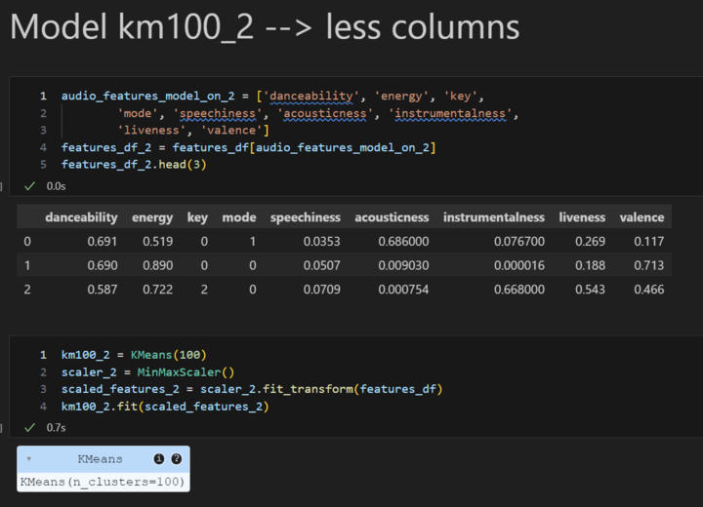
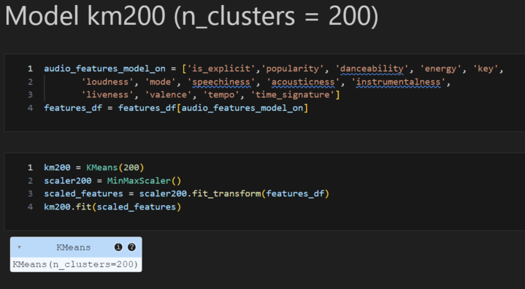
Features

Slide 6
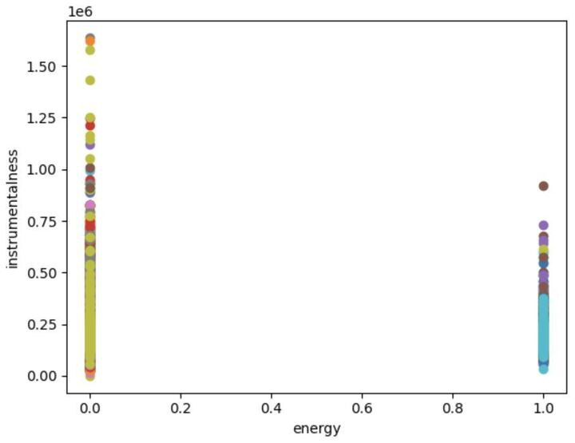
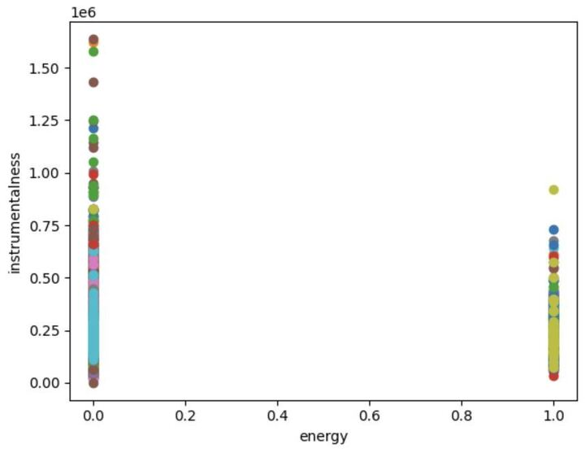
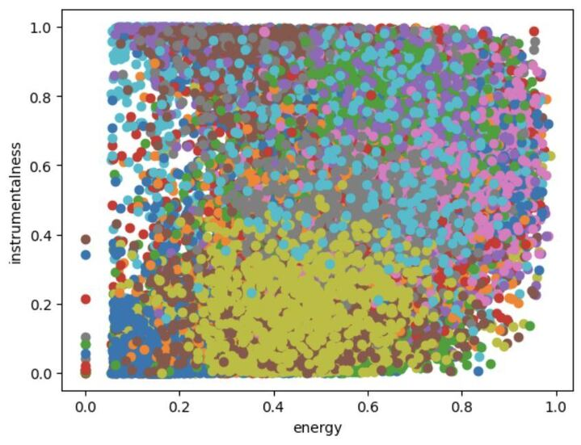
Visualizations
km100(n_cluster = 100)
km200(n_cluster = 200)
km100_2(n_cluster = 100)
km200(n_cluster = 200)

Slide 7
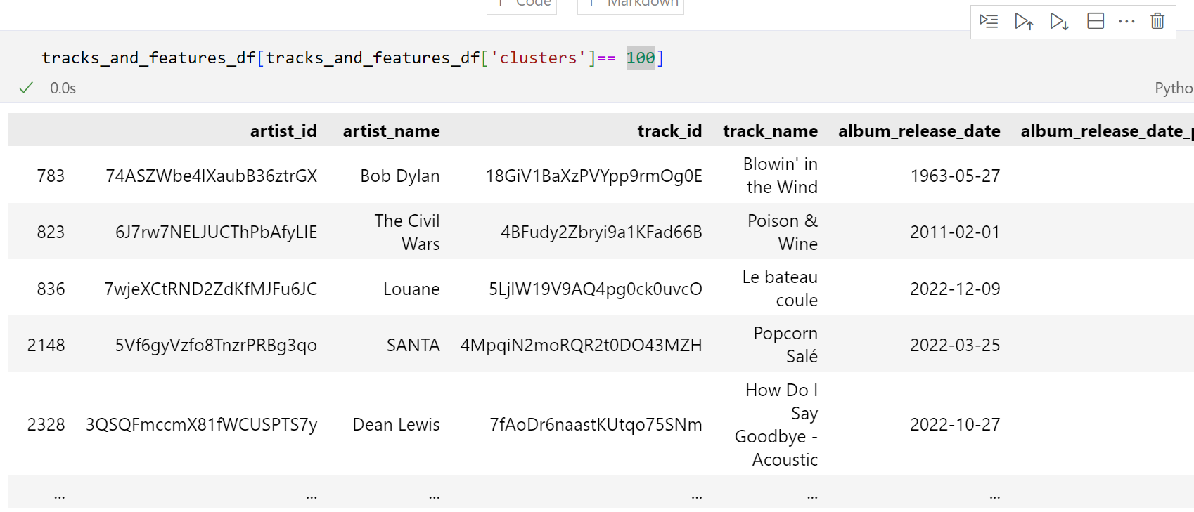
Filter per cluster

Slide 8

TIME TO DEMO !

Slide 9
Thanks!
Please keep this slide for attribution

